Slide 1



Slide 2
Problem
Lack of students willing to do STEM
Plethora of coding resources
Lack of direction for students at a young age
Students, especially under middle school, don’t want to learn
If you tell child to learn code without the why, =no desire

Slide 3
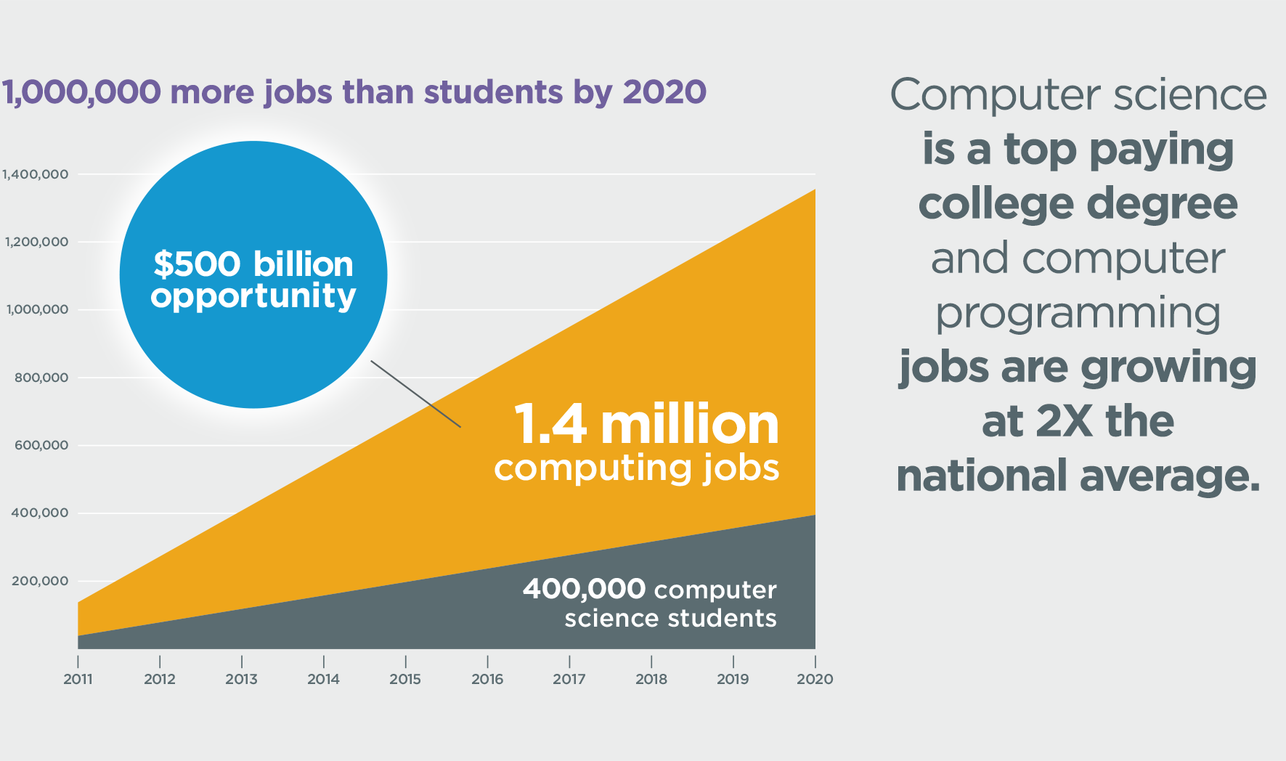

Slide 4
Solution
Sell the child a dream and they will learn while achieving it
Match the student with a mentor with same passions
Inspire STEM education at a young age
Mentor guides student not only with code but vision
Students can participate in local workshops with other students
Teachers can request mentors to come and teach their classes

Slide 5
Target Market
Youth mostly elementary, middle school, some high school
Dream of changing the world

Slide 6
What makes us special?
While others teach code we give inspiration
Empowering children through decision making
Positive impact by inspiring STEM education
Knowing what to do for the future
Encourages innovation and technological advancement in community through local workshops
Plan the future, Create your world

Slide 7
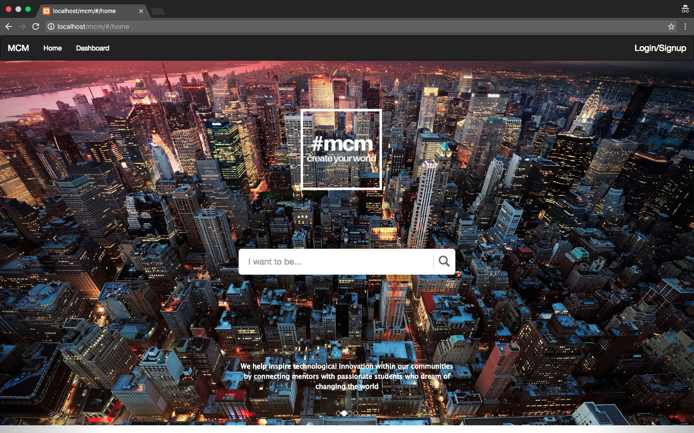
Screenshots of the Application

Slide 8
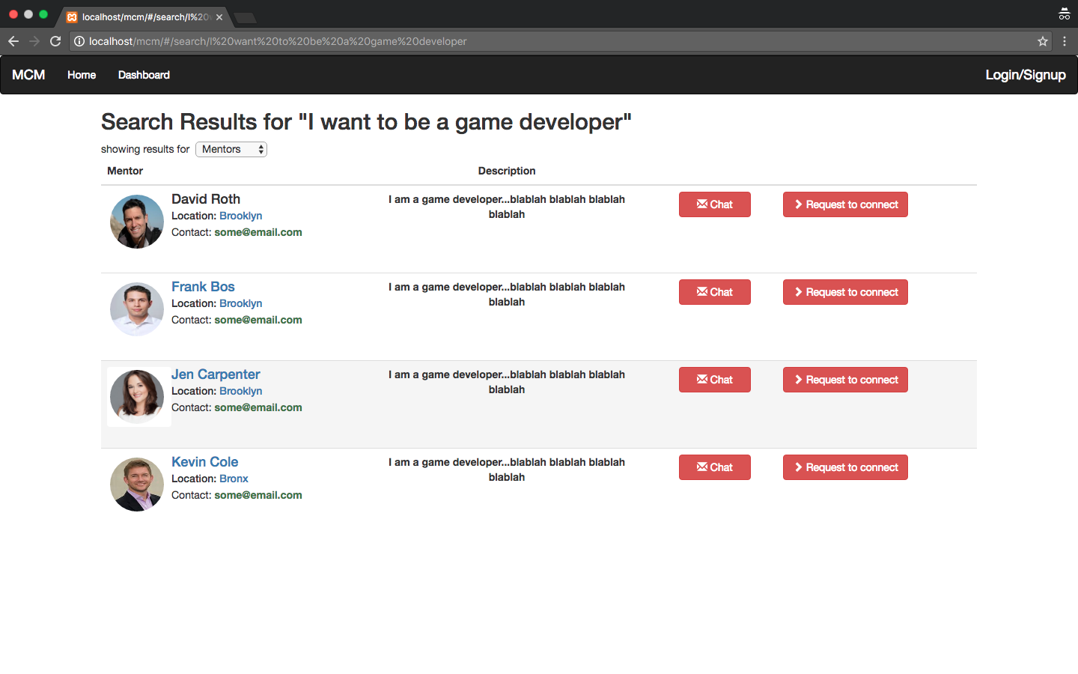

Slide 9
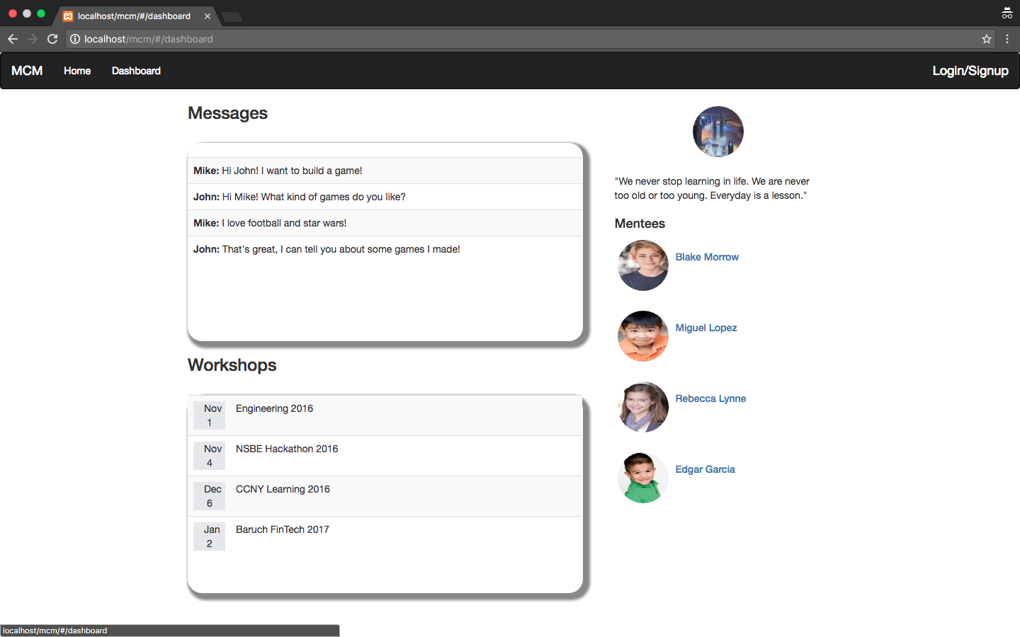

Slide 10
